Slide 1
BITS ZG553: Real Time Systems
K G Krishna
WILP Division, BITS-Pilani, Hyderabad

Slide 2

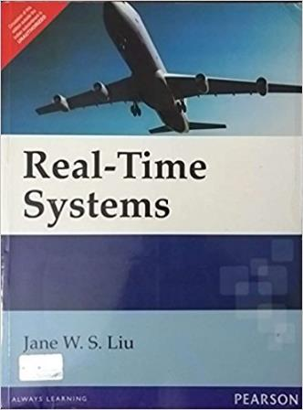
Text Book / References
Reference (R1)
Text Book (T1)
Note: As the above two books focus on theoretical treatment of the subject, Students are strongly advised to refer to web sources / MOOCs videos / library within their own organizations for more practical understanding of the topics.

Slide 3
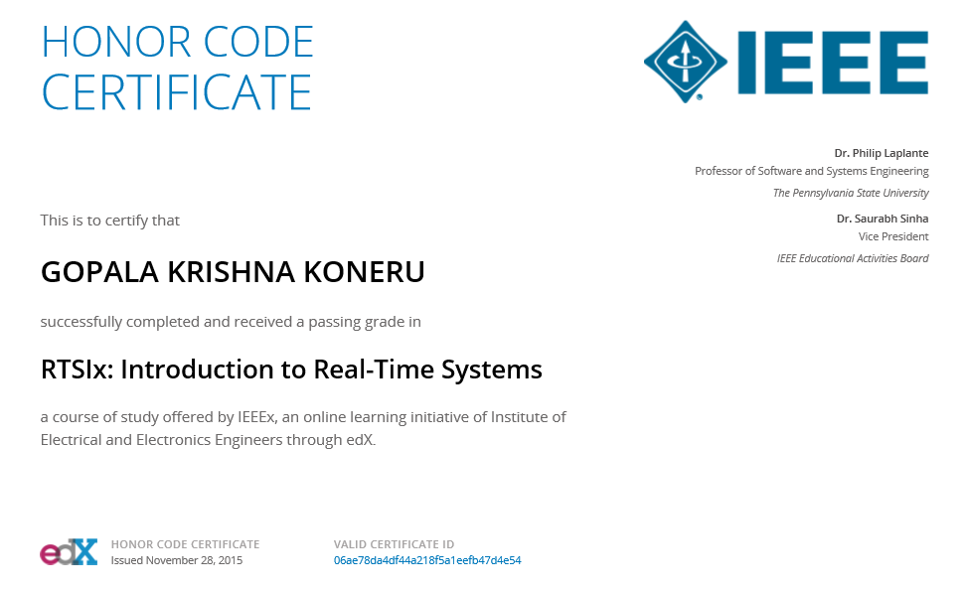
Excellent MOOCs Videos
(Coursera, edX,…)

Slide 4

RTS Primer – For Light Reading

Slide 5
L-2: Real Time Systems –
Definitions/Notations, Task Model, Scheduling Approaches
Ref: T1/ [C3, Lecture PPT/Notes]
Note: Students are requested to NOT to rely on PPTs/Recorded sessions as their only source of knowledge, explore sources within your own organization or web for any specific topic; attend classes regularly and involve in discussions;
PLEASE DO NOT PRINT PPTs, Save the Environment!
Source PPT Courtesy: Some of the contents of this PPT is sourced from Presentations by Prof B Mishra / Prof K R Anupa, BITS-Pilani WILP Faculty

Slide 6
Definitions
A real-time system is a computer system that must satisfy bounded response-time constraints or risk severe consequences, including failure.
A real-time system is any information processing system which has to respond to externally generated input stimuli within a finite and specified period

Slide 7
A Real-Time System
Inputs are excitations and outputs are corresponding responses
Inputs and outputs may be digital or analog
Inputs are associated with sensors, cameras, etc.
Outputs with actuators, displays, etc.
Source: P. A. Laplante & S. J. Ovaska, Real-Time Systems Design and Analysis: Tools for the Practitioner, Wiley, 4th edition

Slide 8
What Is Special about Real-Time Systems?
More number of embedded/real-time systems than desktops
Stricter requirements: More focus on
Timeliness
Robustness
Safety

Slide 9
Soft and Hard Real Time Systems
Soft Real Time System
A soft real-time system is one in which performance is degraded but not destroyed by failure to meet response-time constraints.
User requires only a demonstration that the system always meet some statistical constraints.
Best effort service
Example: Multimedia system
Hard Real Time System
A hard real-time system is one in which failure to meet a single deadline may lead to complete and catastrophic system failure
User requires validation that the system always meet the timing constraint. (validation means demonstration by a provably correct and efficient procedure)
Guaranteed service
Example: Avionics weapons delivery system

Slide 10
Types of Real Time Tasks
Periodic Task
The specified task is executed at a fixed period.
Example: A process control system sampling temperature from a temperature sensor every 5 sec and processing it.
Aperiodic Task
A task is said to be Aperiodic, when it is asynchronously arrived and it has a soft or no deadline.
Example: Low priority interrupts
Sporadic Task
A task is said to be Sporadic, when it is asynchronously arrived and it has a hard deadline.
Example: High priority interrupts

Slide 11
RTS: Reference Model
Each system is characterised by three elements
Workload model:
Describes applications supported by the system
Resource model
Resources available to the system
Algorithms
Algorithm that defines how the system utilizes the resources at all times

Slide 12
Processors and Resources
All system resources are divided into two categories:
Processors
Active resources e.g. Computers, Transmission links, Disks etc
Denoted by P
Resources
Passive resources e.g. Memory, Sequence numbers, Mutexes, Database locks etc
Denoted by R

Slide 13
Assumptions
Many parameters of hard real-time jobs are known at all time
For example, number of tasks in a hard-real time system is known at the beginning
Rate of progress of a job depends upon the speed of the processor on which it executes
Rate of progress of a job doesn’t depend upon the resources it use during execution
Plentiful resources (resources for which no job is prevented from execution) are omitted from the consideration
Memory is considered as a plentiful resource, hence omitted from the consideration

Slide 14
Parameters associated with a Job
Job: Work done by a system e.g. computation of a control law, FFT computation etc (Fast Fourier transform)
Each job J_{i} is characterized by its
Temporal Parameters
Functional Parameters
Resource Parameters
Interconnection Parameters

Slide 15
Timing Specifications
Release Time (r_{i}): The instance of time at which the job becomes available for execution
Deadline : Deadline of a job is the instant of time by which its execution is required to be completed
Execution time (e_{i}): The amount of time required to complete the execution of the job. The actual amount of time required by a job may vary due to various reasons like conditional branches, performance enhancing features like caches and pipelines etc.
Response Time: The length of time from the release time of the job to the instance when it completes
Relative Deadline (D_{i}) : Maximum allowable response time
Absolute Deadline (d_{i}) = Release time + Relative deadline
Timing Constraint is specified in terms of its release time and relative or absolute deadlines
Feasible interval: The time between the release time and the absolute deadline i.e. (r_{i} , d_{i}]
Release Time, Relative Deadline and Absolute Deadline are the Temporal Parameters of Job J_{i}

Slide 16
Example
A system which monitors and controls several furnaces
At the beginning, the system is initialized and starts execution (time 0 ms).
The system samples and reads each temperature sensor every 100 ms.
The system computes the control law of each furnace every 100 ms.
Each of the control law computation is a job, say J_{k}, k = 0, 1, 2, ….
The first control law computation started at 20 ms.
So, release time of first job, r₀ = 20 ms
Subsequent release times: 120 ms, 220 ms, …
So release time of kth job r_{k} = 20 + 100 * k ms
Period p_{k} = 100 ms
If each job needs to be completed within 70 ms, then the absolute deadlines of the jobs: 90 ms, 190 ms, 290 ms, …
Relative deadline D_{k} = 70 ms

Slide 17
Periodic Task Model
Well-known deterministic workload model
Each computation or data transmission is executed repeatedly at regular or semi regular intervals.
Period p_{i} of a periodic task T_{i} is the minimum length of all time intervals between release time of all jobs in it.
Execution time e_{i} is the maximum amount of time required to complete the execution of a task T_{i} when it executes alone and has all the resources it requires.
The accuracy of the periodic model decreases with increasing jitter in release time and variations in execution times.
Tasks in the system are denoted as: T₁, T₂, T₃, …., T_{n}
Jobs in Task T_{i} are denoted as: J_{i,1}, J_{i,2}, J_{i,3}, …., J_{i,k}
The release times of the jobs in Task T_{i} are denoted as: r_{i,1}, r_{i,2}, r_{i,3}, …., r_{i,k}

Slide 18
Timing Specifications – Periodic Task
deadline (D_{i})
deadline (D_{i+1})
response time
response time
execution time (e_{i})
execution time (e_{i+1})
T_{i}
T_{i+1}
period (p)
time
release time (r_{i})
release time(r_{i+1})

Slide 19
Periodic Task Model
The release time of the first job J_{i,1} of Task T_{i} is called Phase Φ_{i} of the Task T_{i} i.e.
Φ_{i} =r_{i,1}
Two tasks are said to be in phase, when they have same phase.
Hyperperiod H of a periodic task T_{i} is LCM of all periods of that task i.e.
H = LCM(p₁, p₂, …, p_{k})
Relative deadline (or simply deadline) D_{i} of a task T_{i} is the maximum allowable time for each job of the task to complete i.e. maximum response time for each job of the task.
We will often assume that for every task, a job is released and become ready at the beginning of each period and must complete by the end of the period. Hence D_{i} will become equal to p_{i} . However, in general D_{i} can have an arbitrary value less than p_{i}.
Absolute deadline of the job J_{i,j}, d_{i,j} = r_{i,j} + D_{i}
Feasible Interval is (r_{i,j} , d_{i,j}]

Slide 20
Periodic Task Model
tasks
Unscheduled view
T1
T2
T3
0 | 1 | 2 | 3 | 4 | 5 | 6 | 7 | 8 | 9
time
Tasks | Φ_{i} | p_{i} | e_{i} | D_{i} | u_{i}
T₁ | 1 | 3 | 1 | 3 | 0.33
T₂ | 2 | 4 | 1 | 4 | 0.25
T₃ | 1 | 5 | 2 | 5 | 0.4

Slide 21
Periodic Task Model
Utilization of task T_{i}
Total Utilization

Slide 22
CPU Utilization Zones
Utilization % | Zone Type | Typical Application
< 26 | Unnecessarily safe | Various
26 – 50 | Very safe | Various
51 – 68 | Safe | Various
69 | Theoretical limit (RM Scheduling) | Embedded systems
70 – 82 | Questionable | Embedded systems
83 – 99 | Dangerous | Embedded systems
100 | Critical | Marginally stressed system
> 100 | Overloaded | Stressed system

Slide 23
Parameters Summary
Precedence constraints: specifies if any task(s) needs to precede other tasks.
Release or arrival time r_{i,j}: the release time of the j^{th} instance of task .
Phase: Φ_{i} the release time of the first instant of task .
Response time: Time span between the task activation and its completion.
Absolute deadline d_{i}: is the instant of time by which the task must complete.
Relative deadline D_{i}: is the maximum allowable response time of the task.
Laxity type: Notion of urgency or leeway in a task's execution.
Period p_{i}: is the minimum length of intervals between the release times of consecutive tasks.
Execution time e_{i}: is the (maximum) amount of time required to complete the execution of a task i when it executes alone and has all the resources it requires.

Slide 24
Aperiodic and Sporadic jobs
We call a task to be aperiodic if the jobs in it have either soft deadlines or no deadline.
Example: Task to adjust radar’s sensitivity
We call a task to be sporadic when the jobs are released at random time instants, but have hard deadlines.
Example: A command and control system (of airplane control) must process sporadic data messages in order to continuous voice and video traffic.

Slide 25
Timing Specifications – Aperiodic & Sporadic Task
deadline (D_{i})
response time
execution time (e_{i})
T_{i}
time
release time (r_{i})

Slide 26
Precedence Constraints, Predecessors and Successors
Jobs are said to have precedence constraints if they are constrained to execute in some order.
If jobs can execute in any order, they are called independent.
A job J_{i} is a predecessor of another job J_{k} if J_{k} can’t begin execution until the execution of J_{i} completes. It is denoted by
J_{i} < J_{k}
Here J_{k} is a successor of J_{i} .
Let us consider the relation J_{i} < J_{j} < J_{k .}
J_{i} is a immediate predecessor of J_{j} and predecessors of J_{j} and J_{k}
J_{k} is a immediate successor of J_{j} and successor of J_{i} and J_{j}
A job with predecessors is ready for execution when the time is at or after its release time and all of its predecessors are completed.

Slide 27
Three Approaches for Scheduling Real Time System Tasks
Clock-driven
Round-robin / Weighted round-robin
Priority-driven

Slide 28
Clock-driven Approach
Scheduling decisions are made at specific time instants, which are chosen a priori before the system begins execution
Typically this type of scheduling is suitable for hard real-time systems and smaller systems, where the parameters are fixed and known.
Scheduling decisions are computed off-line and stored for use at run-time, thus scheduling overhead is minimal.
Generally a hardware time is set to expire periodically.
After the system gets initialized, the scheduler selects and schedules jobs which execute till the next scheduling decision is made. Then the scheduler blocks itself waiting for the expiration of the timer.
When the timer expires, the scheduler wakes up, does necessary scheduling and sleeps again. This process repeats.

Slide 29
Round-robin Approach
Also known as time-sharing
Every job joins a FIFO (First-in-first-out) queue when it becomes ready for execution
The entire time period is divided into several time-slices
The job at the head of the queue executes for one time-slice.
If the job doesn’t complete at the end of the time-slice, it gets pre-empted and placed at the end of the queue to waits for its next turn.
If there are ‘n’ jobs ready for execution, each job gets 1/nth share of the processor.

Slide 30
Round-robin Approach - Example
 | J_{1,1} | J_{2,1} | J_{1,2} | J_{2,2} | J_{1,3} | J_{2,3}
0
q
2q
3q
4q
5q
6q
time
(Round-robin execution of two tasks on a single processor)
(Time quantum = q)

Slide 31
Weighted round-robin Approach
This approach is a round robin approach with different weights assigned to different jobs.
If a job has weight ‘wt’, then it will get ‘wt’ time slices every round for execution.

Slide 32
Priority Driven Approach
Priorities are assigned to the jobs based on their criticality
Jobs ready for execution are placed in one or more queues ordered by priorities of the jobs.
At any scheduling decision time, the jobs with the highest priorities are scheduled and executed on the available processors.

Slide 33
Priority-Driven Approach - Example
3 Jobs to be scheduled based on priority-driven approach:
J1: priority 1, release time 15, execution time 10
J2: priority 2, release time 0, execution time 30
J3: priority 3, release time 18, execution time 20
Rules:
Each process has a fixed priority (1 highest);
Highest-priority ready process gets CPU;
Process continues until done.

Slide 34
Priority-Driven Approach - Example
J3 ready t=18
J2 ready t=0
J1 ready t=15
J2
J1
J2
J3
0
10
20
30
40
50
60
time

Slide 35
Priority-Driven vs Clock-Driven Approaches
Priority driven approaches have many advantages compared to clock driven approach:
They don’t have to have the information on the release time, execution time etc (in contrast with clock driven approach, where these parameters are required to be known a priori)
It is best suited for applications with varying time and resource requirements
Many well-known priority –driven algorithms use very simple priority assignments reducing the overhead of maintaining multiple queues.
Despite all these advantages, Clock-driven approaches are used for hard real-time systems, especially in safety-critical systems.
The major reason is that the timing behaviour of a priority-driven system is nondeterministic when job parameters vary.

Slide 36
What to do if CPU is getting overloaded ?
CPU is said to be overloaded, when the Utilization > 1.
What to do in this case?
Reduce Execution Time !
How to do it ?
Replace the CPU with a faster CPU
CPU with higher frequency
CPU with more cores
CPU with a deeper pipeline and more cache
Add more RAM (it will reduce the page fault overhead)
Have dedicated Hardware (e.g. custom ASICs, DSP Processors) for specific functions
Optimize the code
…

Slide 37
Thank You.
Any Questions?

